Slide 1
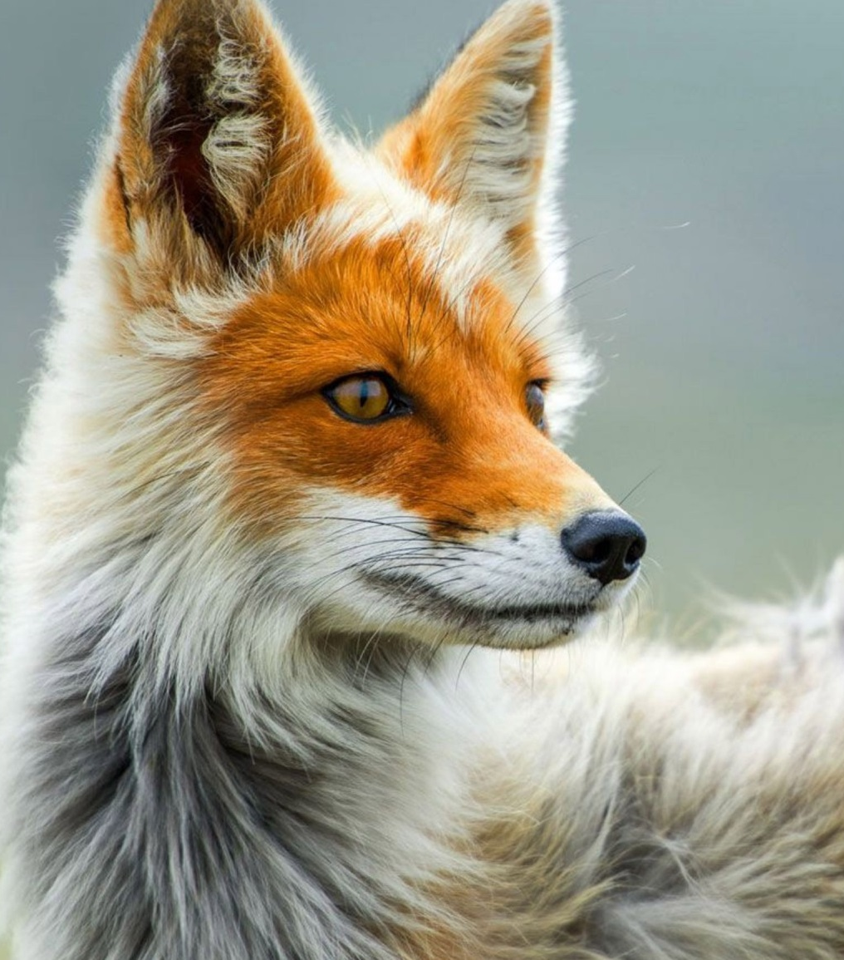

Cardiff Wildlife Application
Presentation by Rikhardur Snaebjornsson, Sarah Lopes, Joe Baxendale and Finlay Wallis

Slide 2
So what is our Application?
Makes you aware of local wildlife
You can post sightings and enquiries to our newsfeed
You can view other people’s posts using our newsfeed
Allows you to search for an animal using its characteristics.

Slide 3
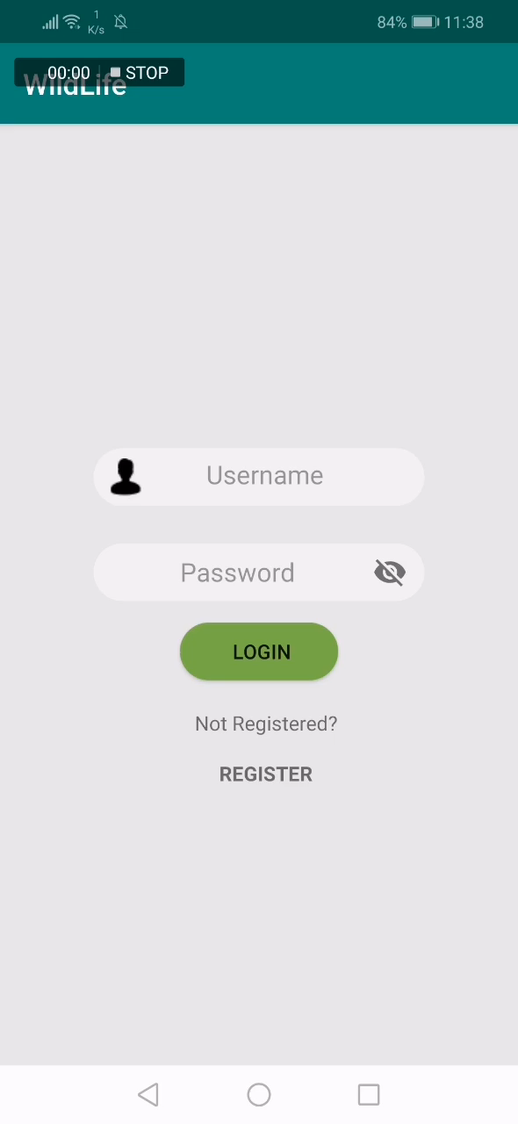
Register and Login

Slide 4
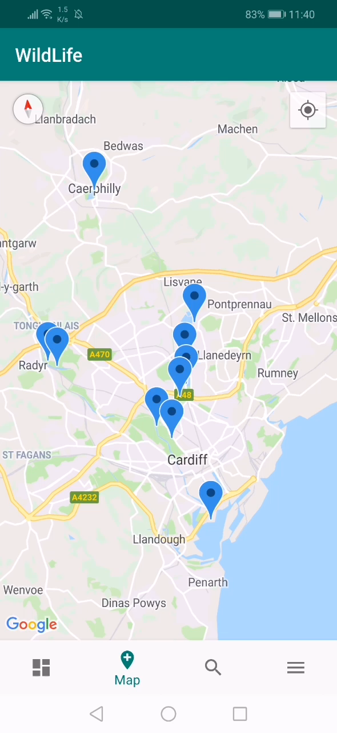
Map

Slide 5
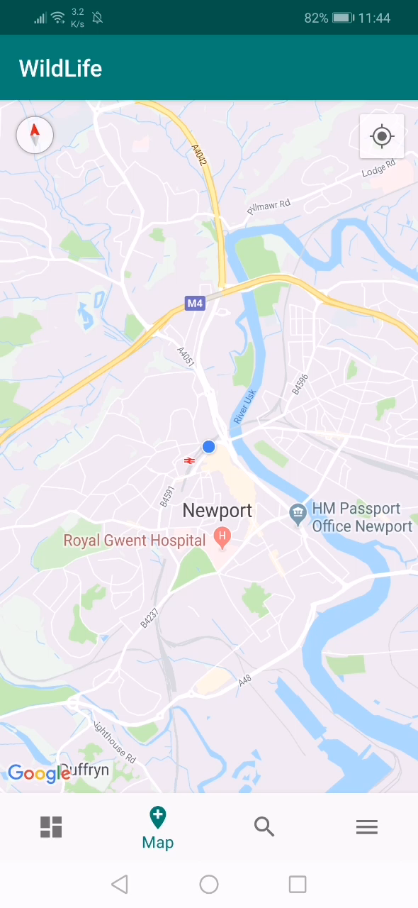
Search

Slide 6
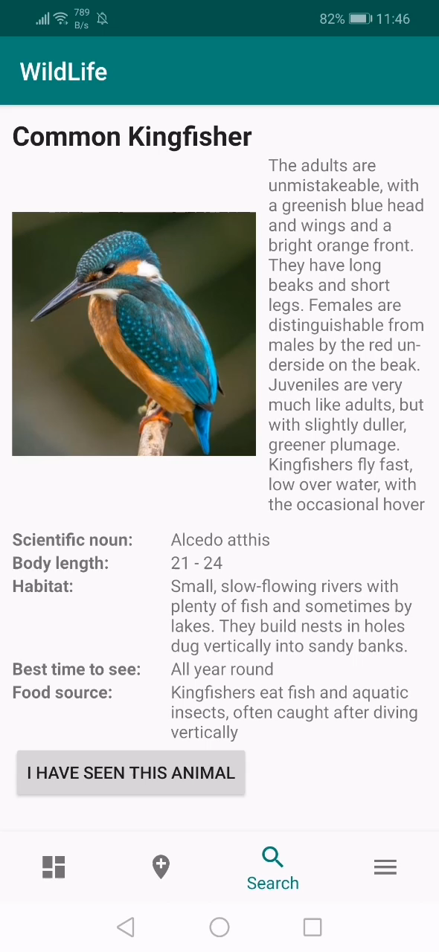
Submitting a sighting of an animal

Slide 7
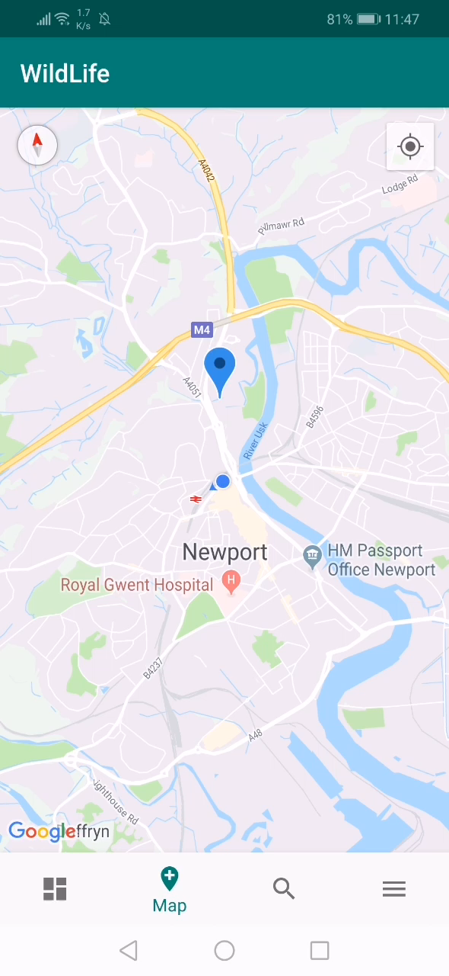
Newsfeed

Slide 8
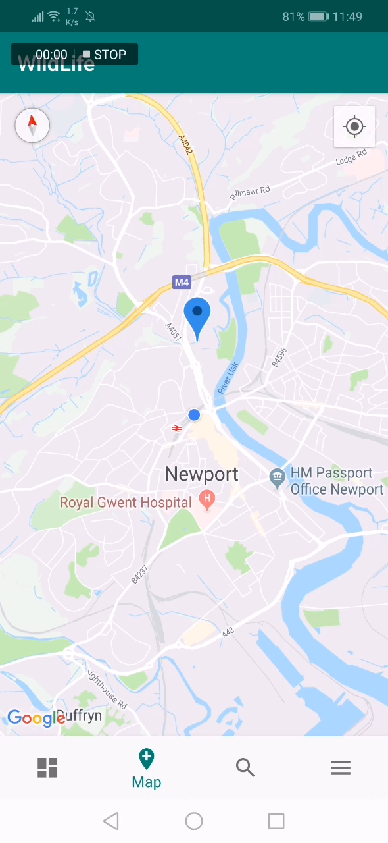
Settings and Statistics

